Slide 1
有文字的PPT只是作为提示切换时机的备份，实际上是隐藏的不会播放出来

Slide 2
背景和演戏时台上演员的布局是否一致要再看看，不对的话可以镜像/翻转

Slide 3
动画和细节之后再调整

Slide 4
Act 1. Scene 1

Slide 5
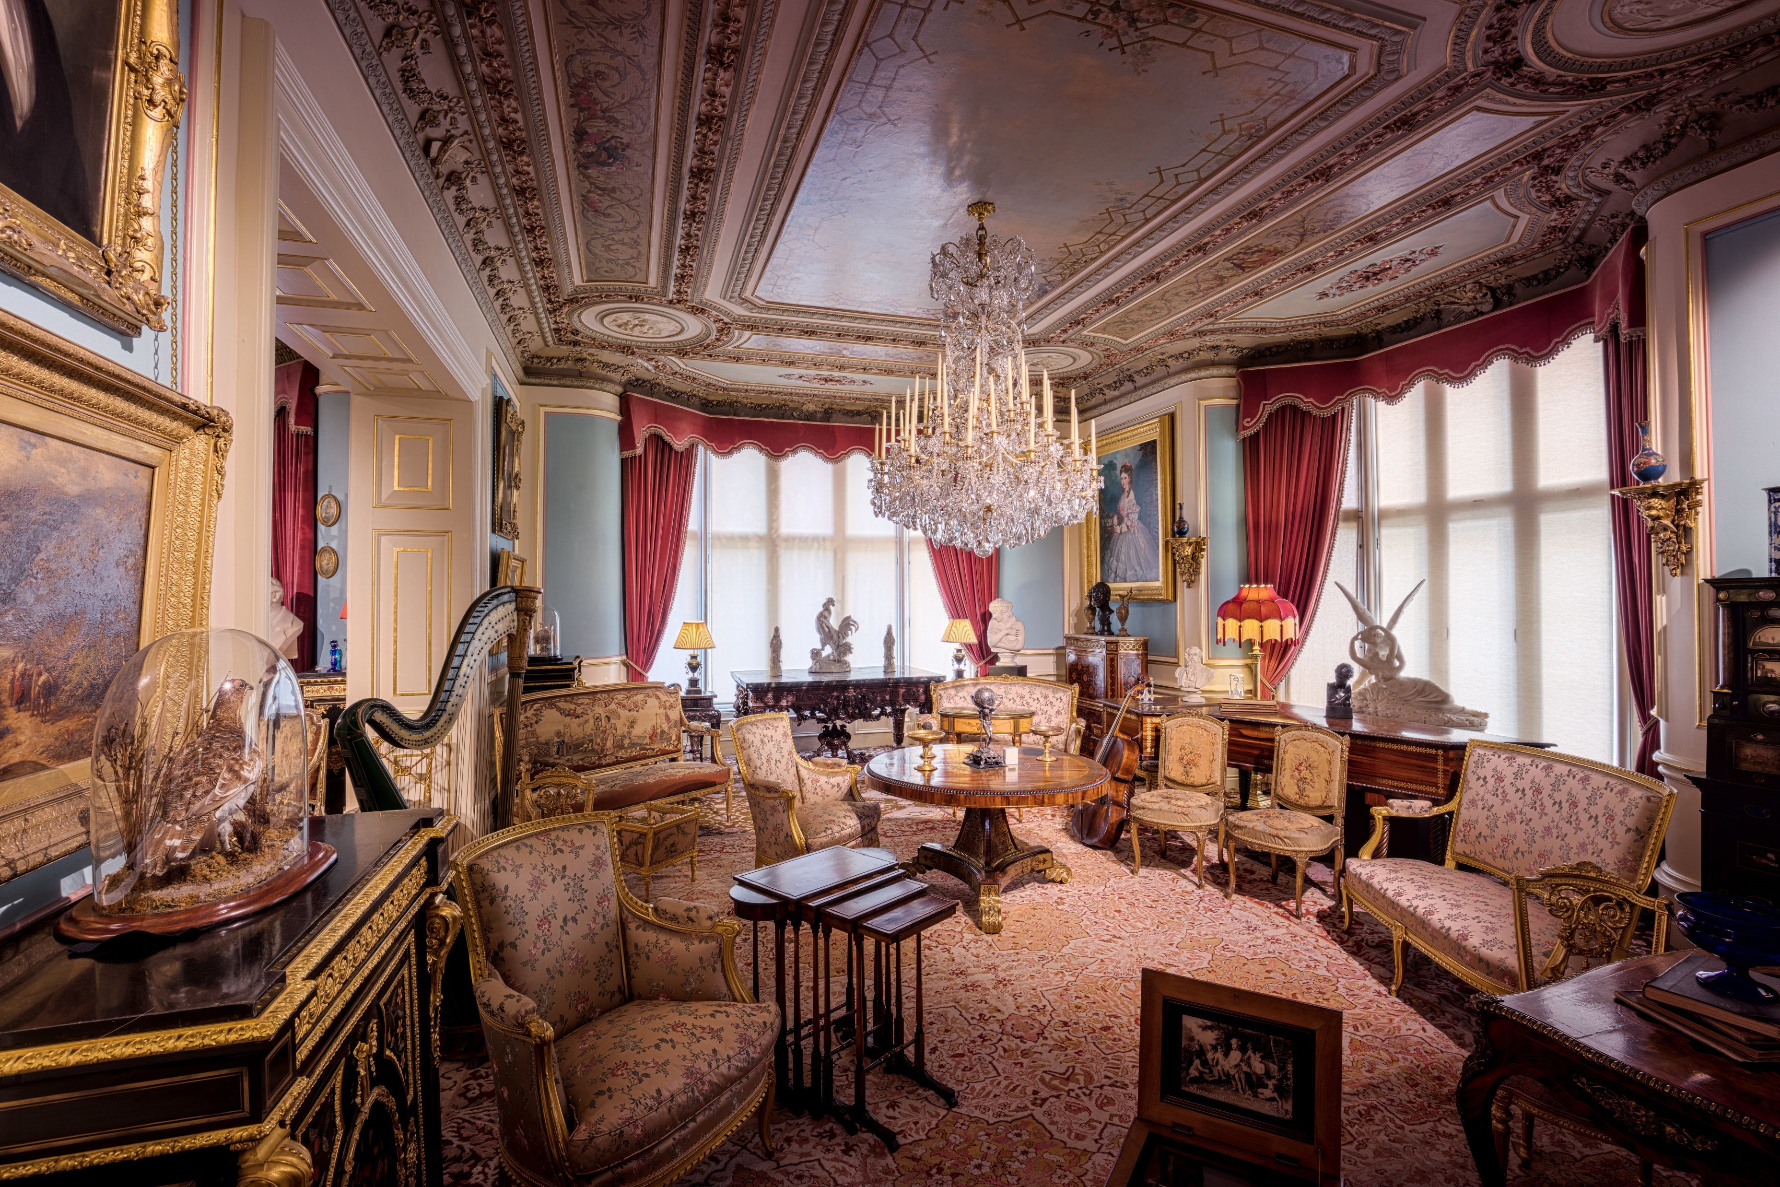
两个老头密谋打赌的场景 找不到合适的☹

Slide 6
Act 1. Scene 2
Last scene ending with:
Mr. G: (frown) A bet? Oh gentlemen, I am astonished at your purpose, and that you should call it ... a scrap of paper. Allow me to draw your attention to the text. (reads, slowly and carefully) I promise to pay the bearer on demand the sum of one million pounds.
(R.M. and O.M. looked at each other, smiled again and nodded without saying a word.)

Slide 7
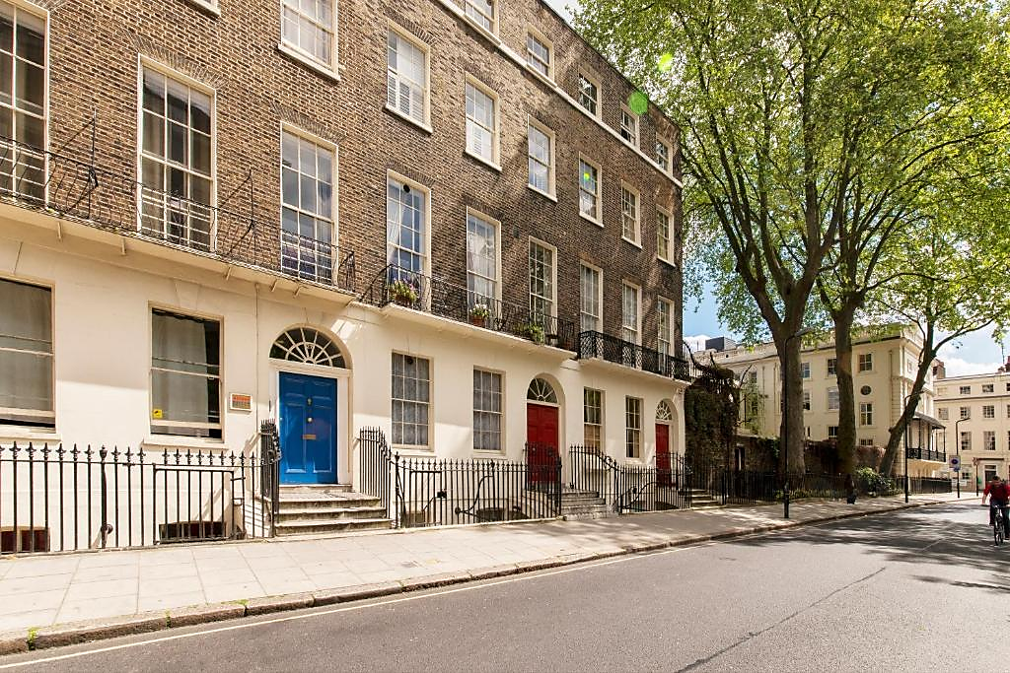
Abandoned

Slide 8
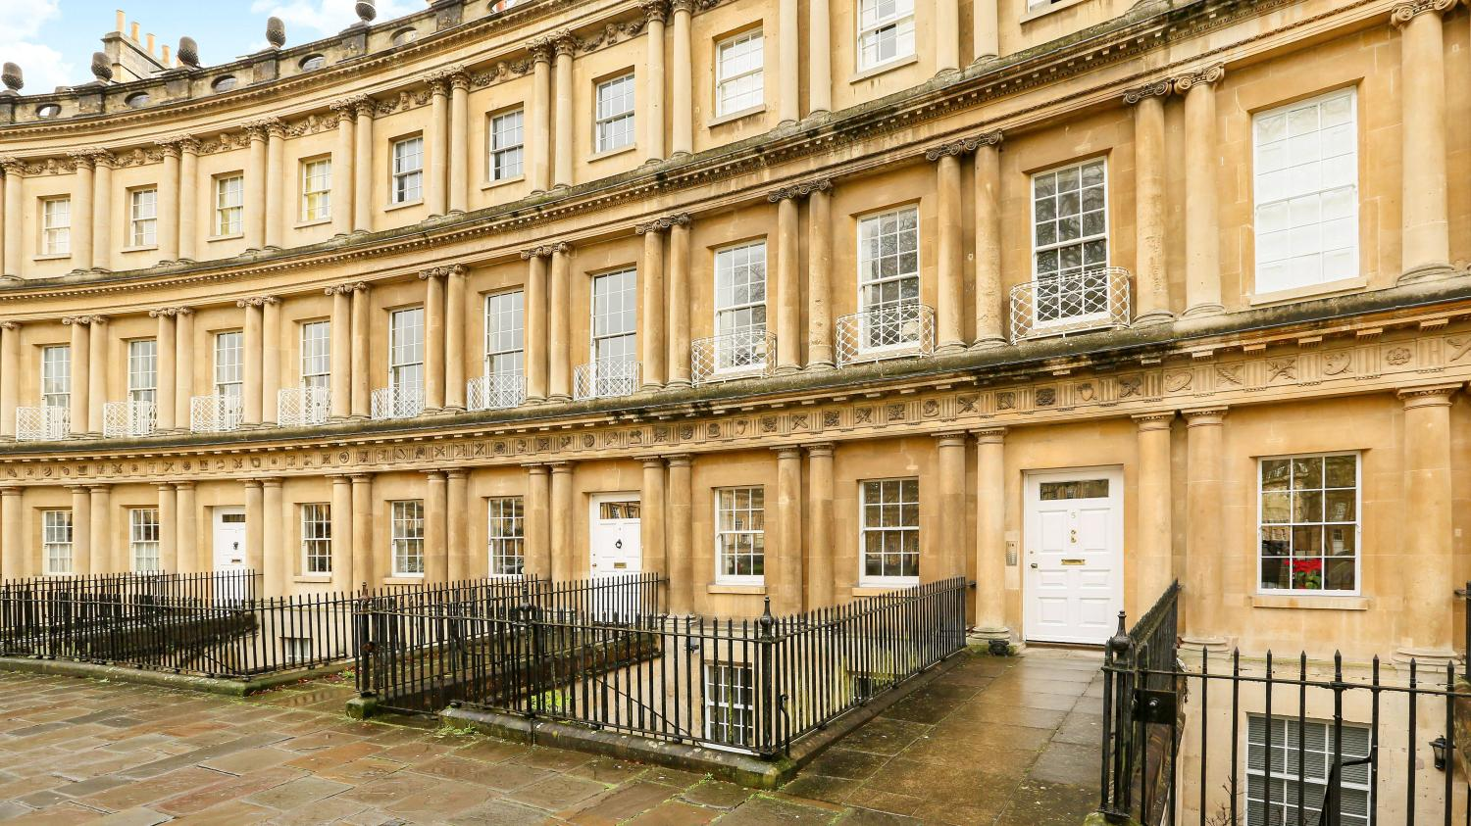

Slide 9

两个老头密谋打赌的场景 找不到合适的☹

Slide 10
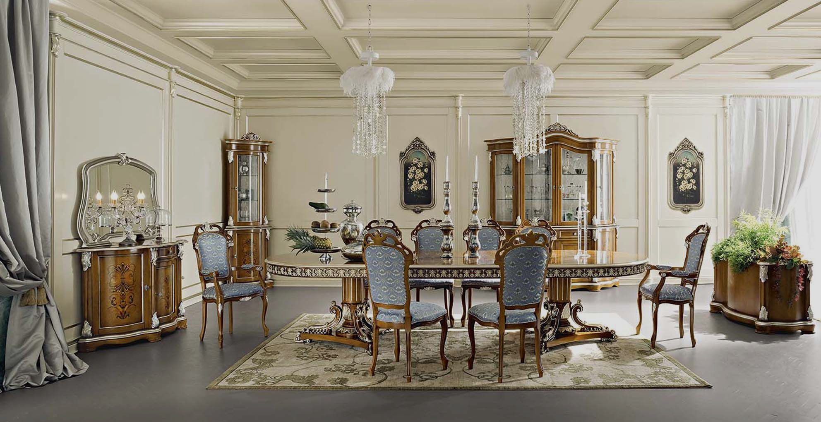
弃用 已隐藏
两个老头密谋打赌的场景 找不到合适的☹

Slide 11
Act 2
NB: 此处更换为两个场景，后面裁缝将其领入豪华间，在 C.S.M.: Allow me sir. Er... This way, sir. (C.S.S.2 showing Henry his second costume in this play, which he will put on later) 之后切换。
Last act ending with:
(O.M. and R.M. standing up too)
R.M.: Mr. Adams! (pause for a while, then with a smile) Wish you good luck.
H.A.: (slightly sighing) Thank you, sir. Goodbye.

Slide 12
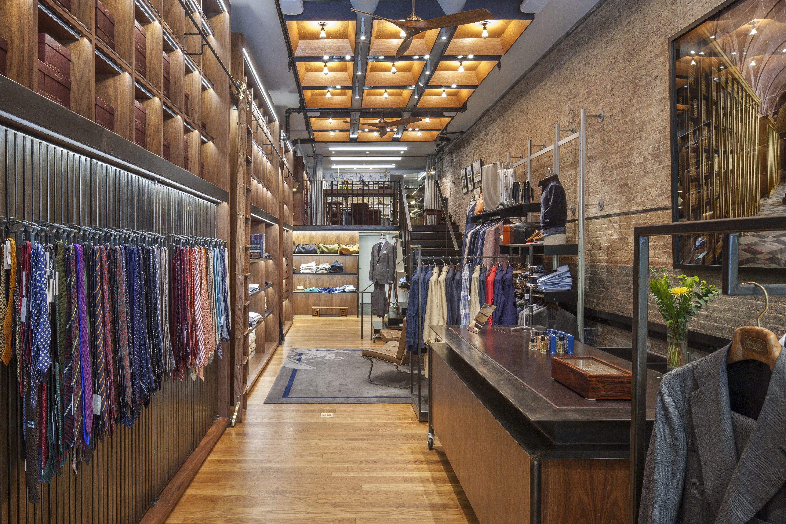
Abandoned

Slide 13
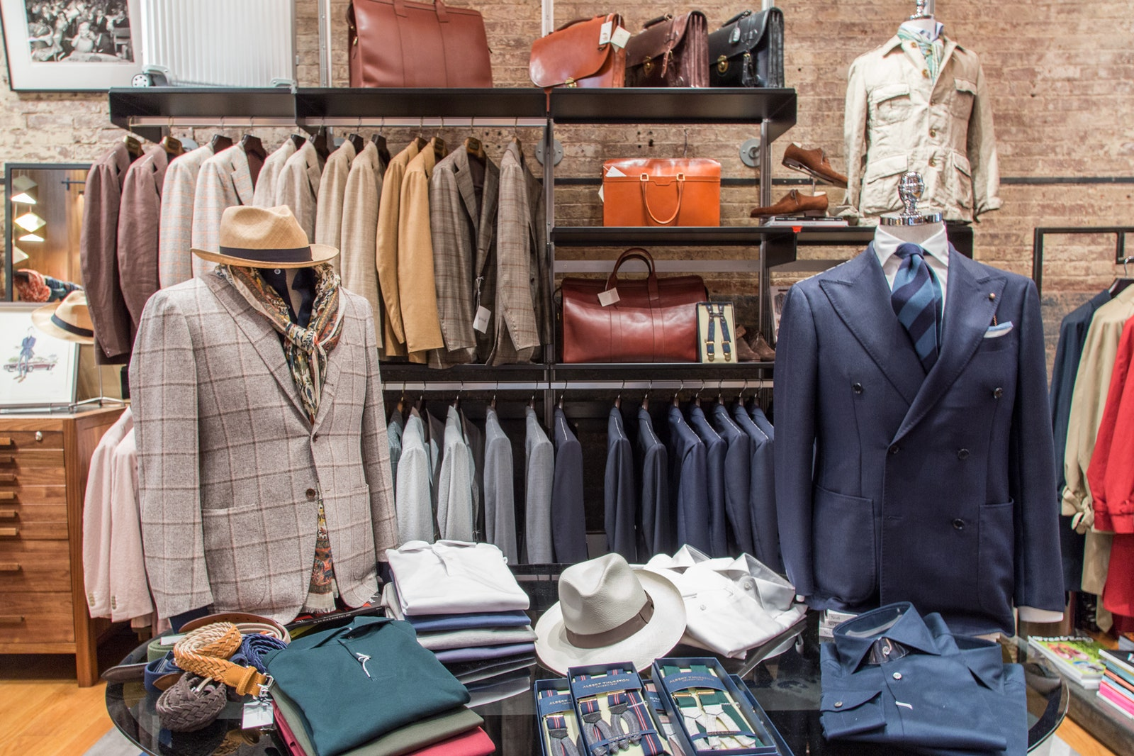

Slide 14
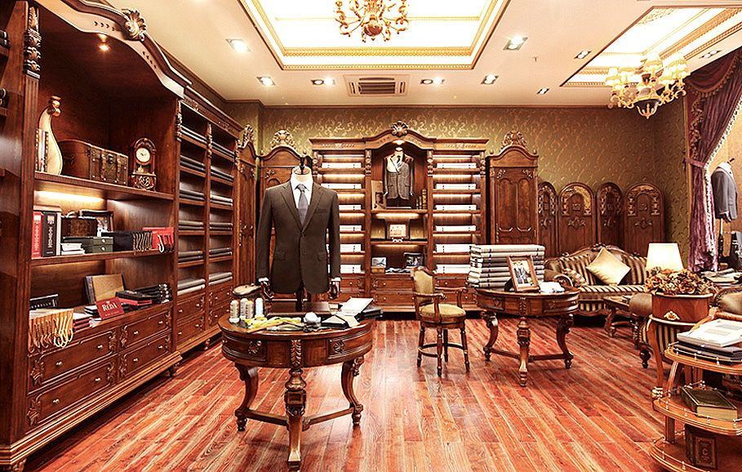

Slide 15
Act 3
Last act ending with:
H.A.: Bumbles?
C.S.M: The very place, quiet, modest and discretion itself. (with a very very sycophantic smile) Luckily for you I have a relative on the management. Leave it to me.

Slide 16
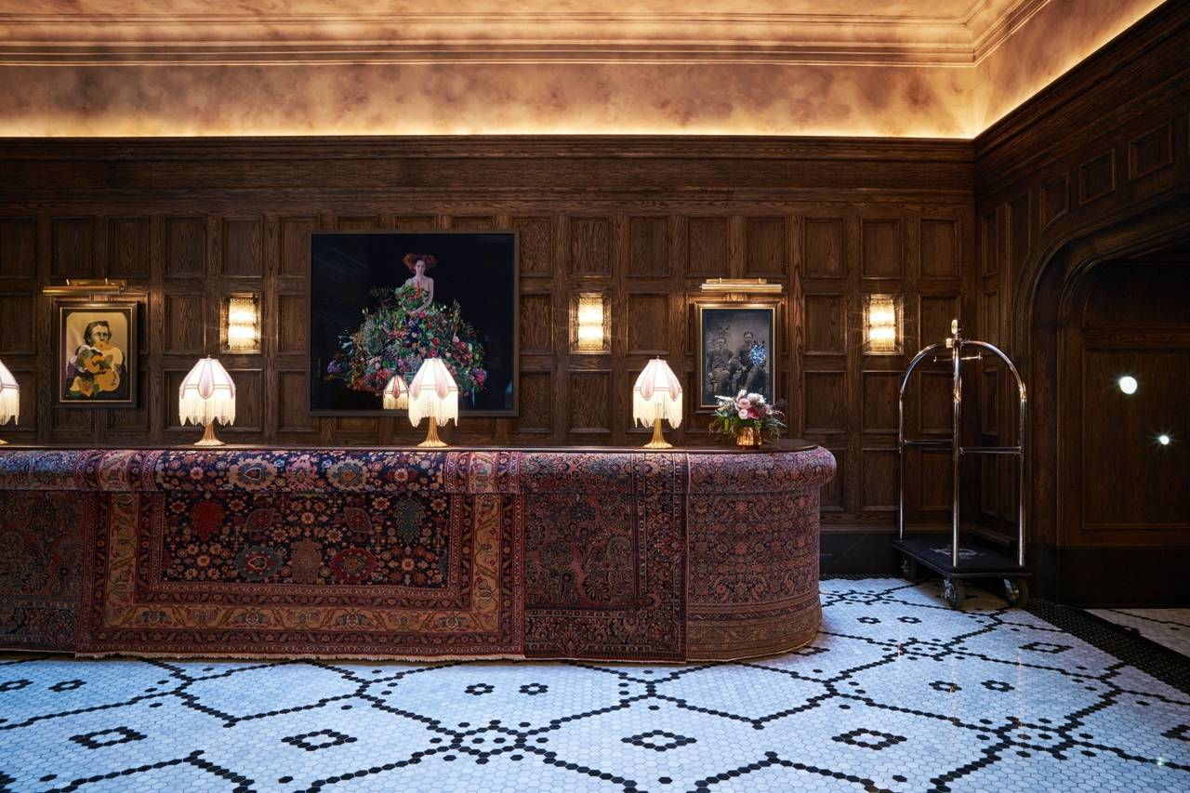

Slide 17
Act 4. Scene 1
Last act ending with:
Rock: (Holds out his hand)
H.A.: (Shakes hands with Rock) (To Rock, proudly) For the next month, I’m H.A., the American Millionaire.

Slide 18
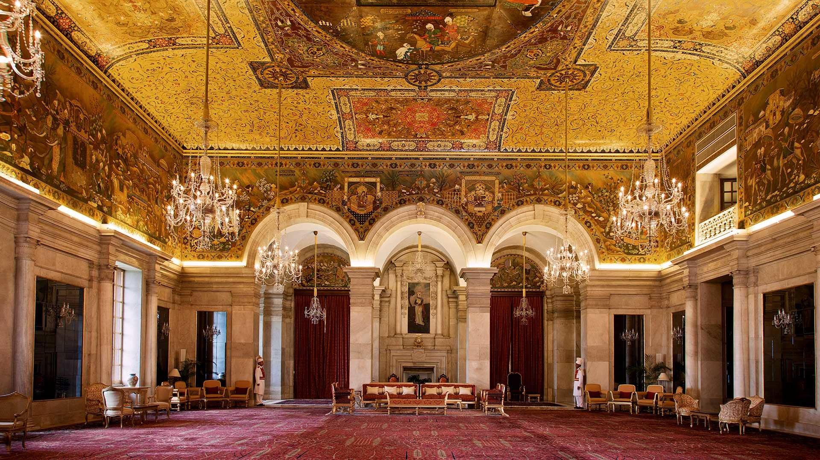

Slide 19
Act 4. Scene 2
NB: 此处图片均由 DALL·E 绘制。
Last scene ending with:
Guest 3: Now, Mr. Adams, I want you to make the acquaintance of Sir William Collins...
(H.A. and Guest 3 off the stage)
Guest 1: A man of character!
Guest 2: We must invite him to lunch!

Slide 20



Slide 21
Act 5
Last act ending with:
(Henry and P.L. off the stage.)
N.: Henry is invited to the Home for Motherless Babies. After taking a look at the babies, he is taken to a charity auction. He doesn't want to donate much, but is urged by the audience to donate five thousand pounds.

Slide 22
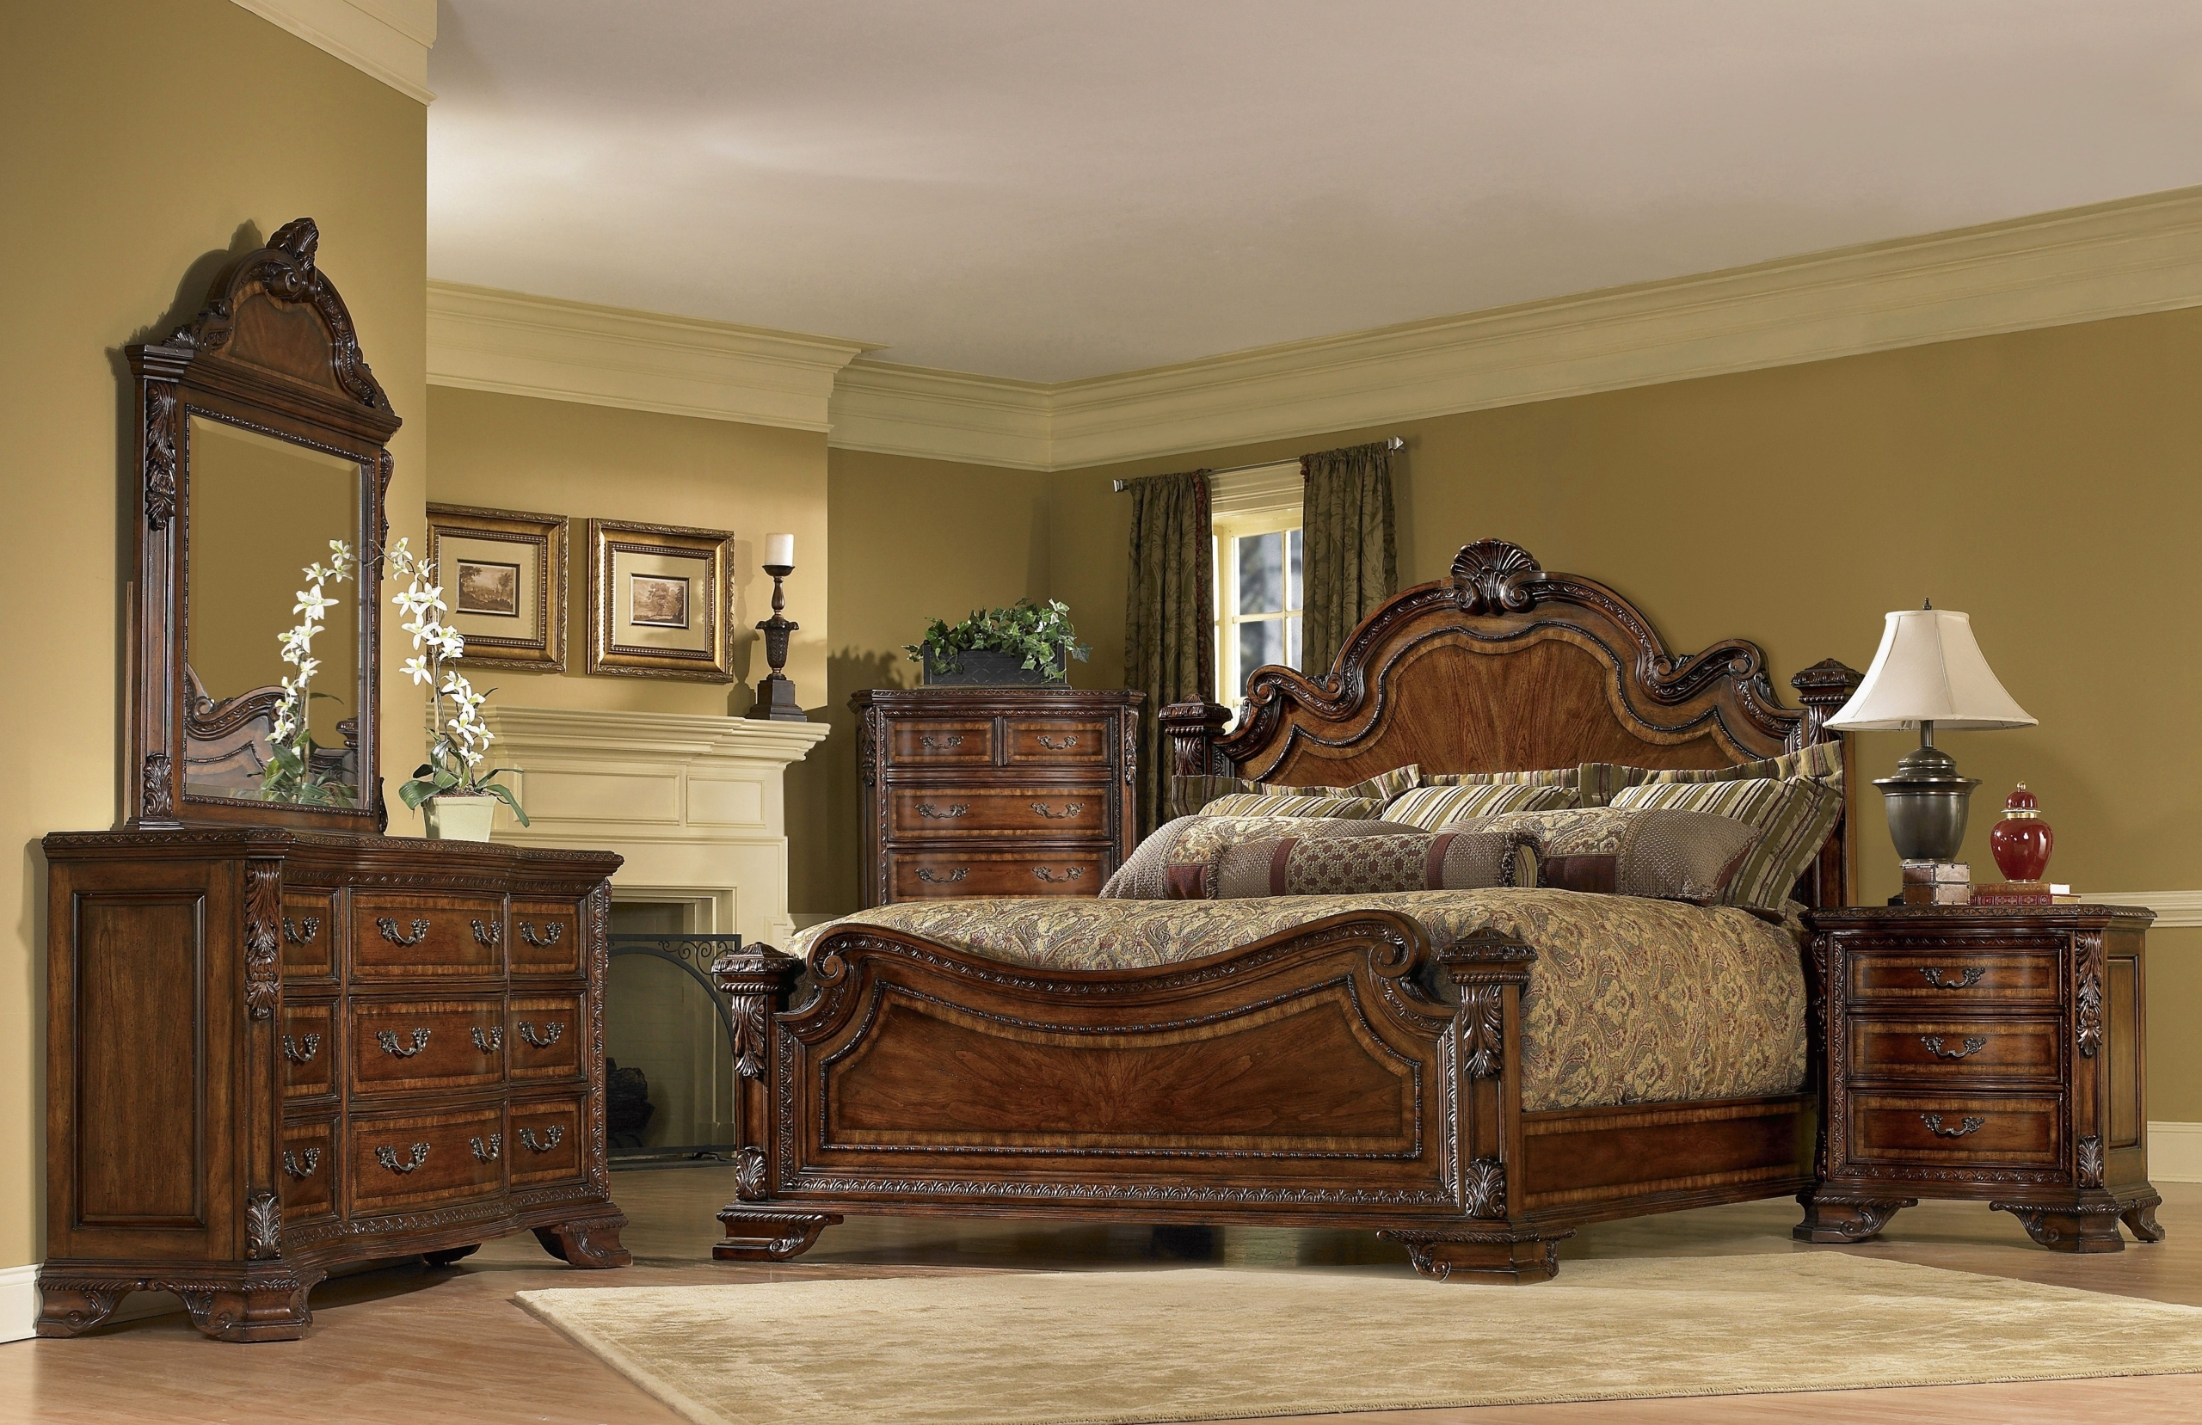
Abandoned

Slide 23
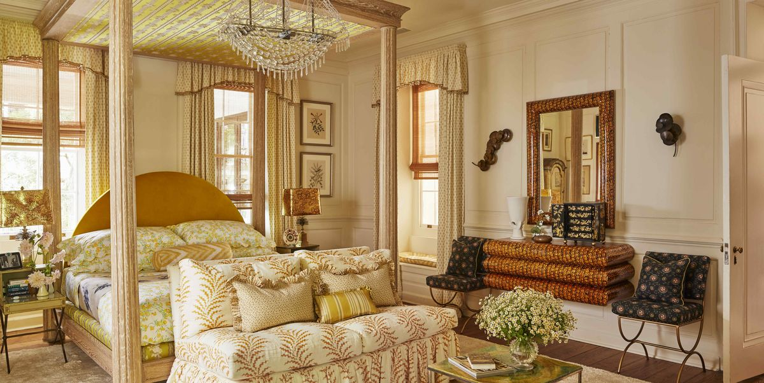

Slide 24
Act 6
Last act ending with:
H.A.: (Cheerfully) Rock! We're not going. (Tapping Rock on the shoulder) Things always look bad at night. But in the morning the sun is shining and the birds are singing. We can't throw in the cards like this when the game is only halfway through.

Slide 25
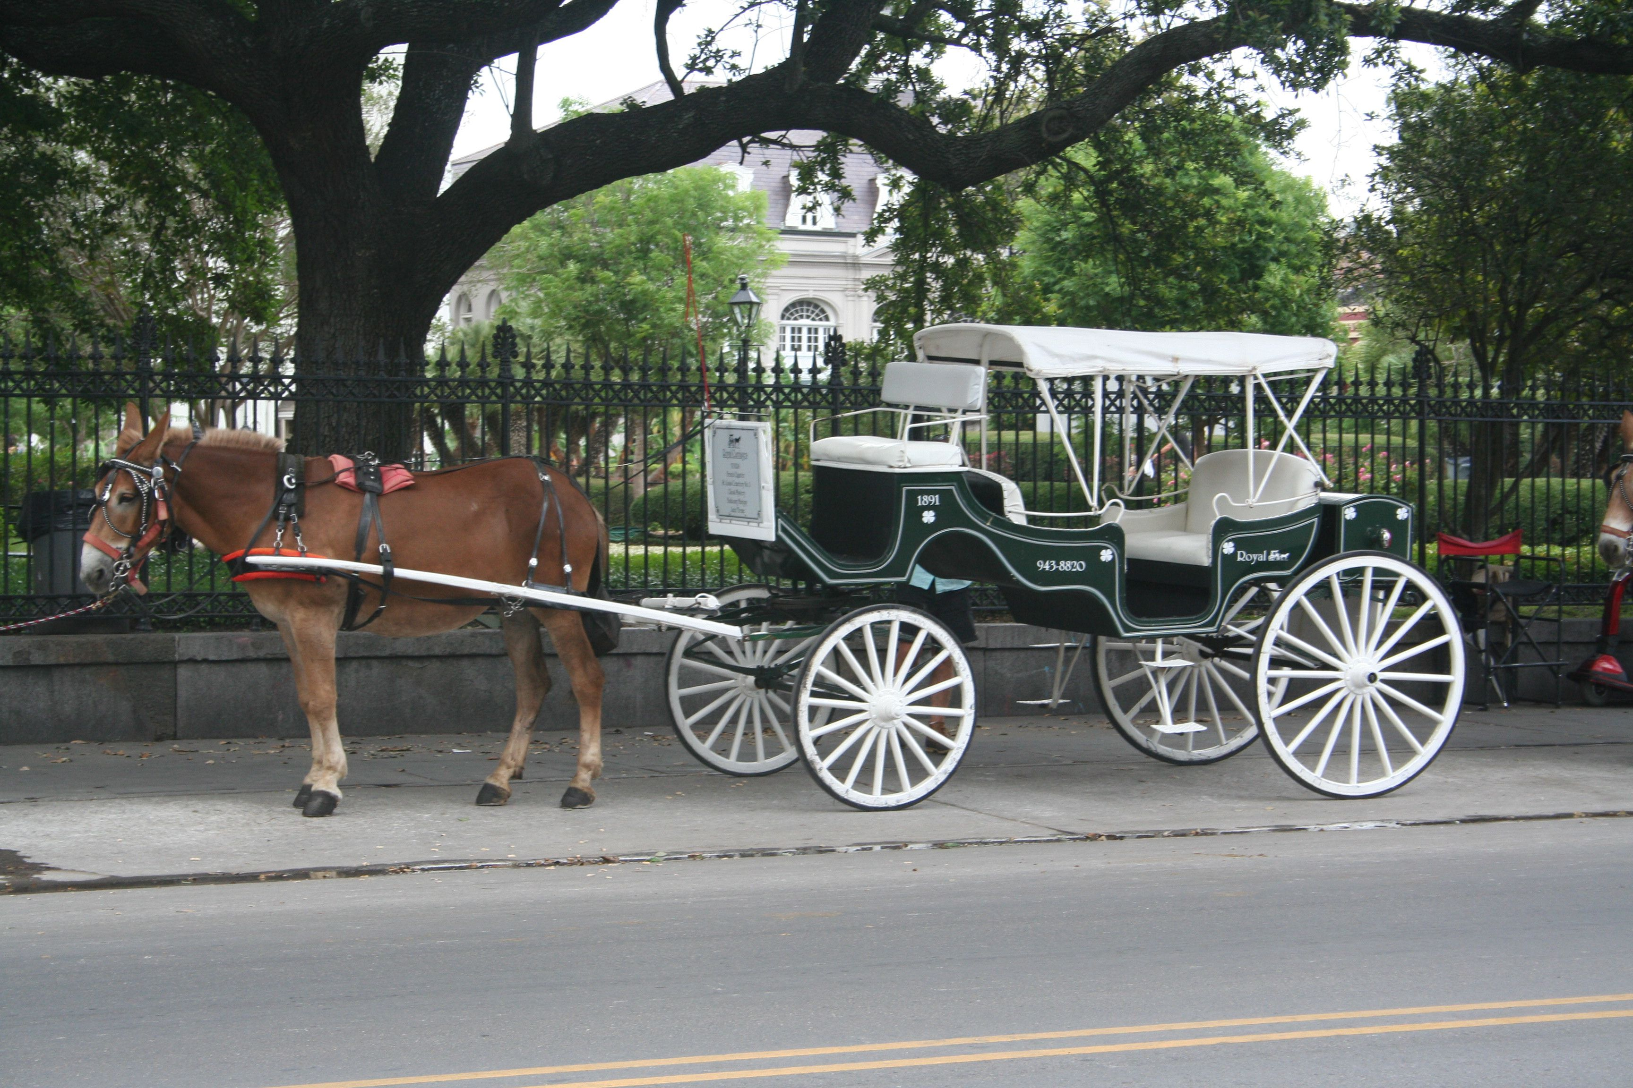

Slide 26
Act 7. Scene 1
Last act ending with:
Mr.H.: (Excitedly) I may use your name! Your name - think of it! Man, they'll flock in droves, these rich Londoners; they'll fight for that stock! I'm a made man, I'm a made man forever, and I'll never forget you as long as I live!

Slide 28
Act 7. Scene 2
NB: 这里的图片仍有提升空间; 图片展现的内容最好稍微弄得奢华一点, 但风格不能是现代的。
Last scene ending with:
M.bum: He's a public figure, your grace, of considerable standing.
D.F.: Stuff and nonsense! (irritated, angrily leaves the counter without even picking up the bank notes)

Slide 29
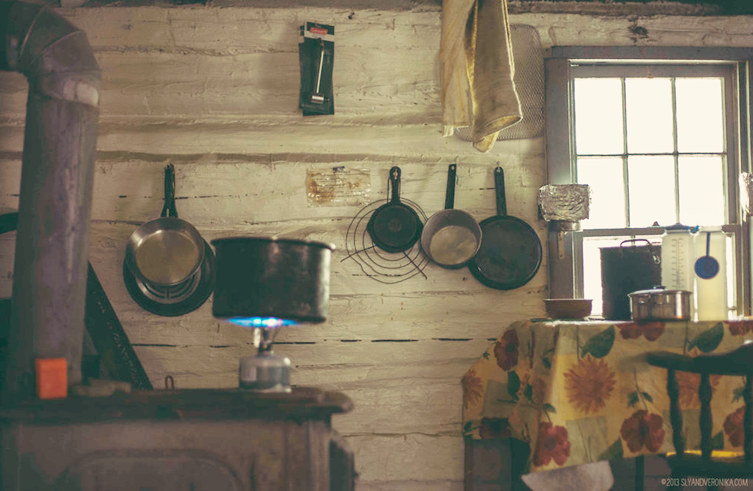

Slide 30
Act 7. Scene 3
Last scene ending with:
N.: (Renie.Bum acts correspondingly) And so Renie gracefully strode into Henry's suite with the subterfuge of a cleanup. Smartly lurking behind Henry's views, she adeptly took the cheque out of Henry's clothes in the wardrobe and hid it right beneath the carpet - just like a skillful prowler. Poor Rock didn't even took notice of Renie's presence.
(Renie.Bum returned to Duke of Frognal who feigned a praise and left)

Slide 31
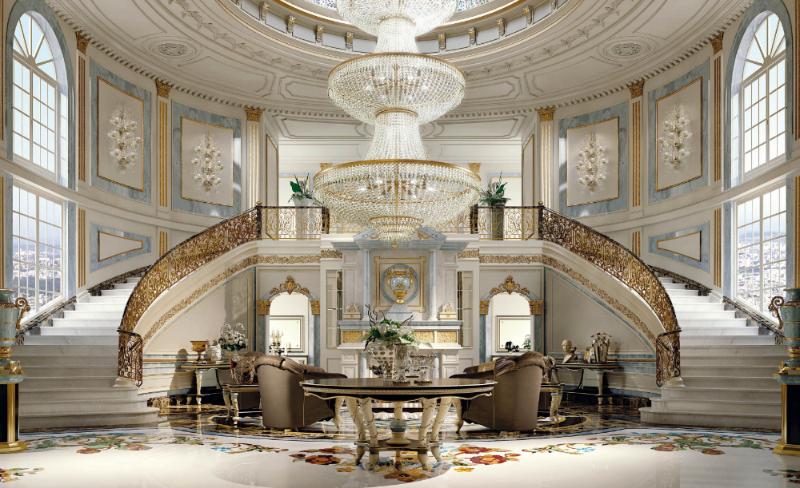

Slide 32
Act 7. Scene 4
Last scene ending with:
Duchess.C.: No, my dear. If you were an ordinary girl it wouldn't matter. But, alas, we are not an ordinary family.
(Aunt locks the door, with P.L. desperately pounding from inside)
P.L. Let me out!

Slide 33
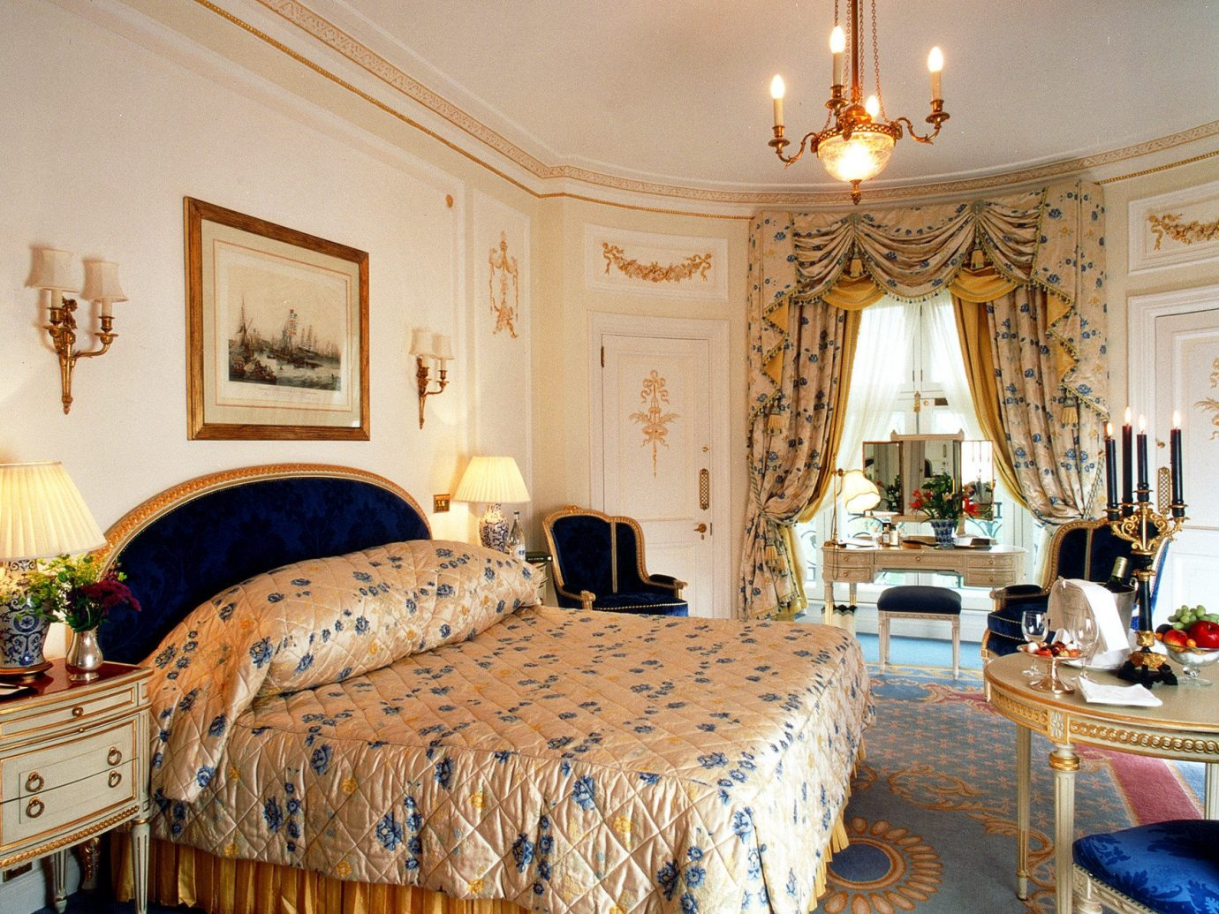

Slide 34
Act 7. Scene 5
Last scene ending with:
H.A.: (pensive, but then delighted when he reminisced of Hastings' shares) I'll settle my accounts in full this aternoon. It so happens that my real fortune is tied up in mining ... gold mining. Well, good morning, gentlemen. You're a fascinating species. Sometime you must take a good look at yourselves (hurry out the doorway, arrogant) ... under a microscope.

Slide 35
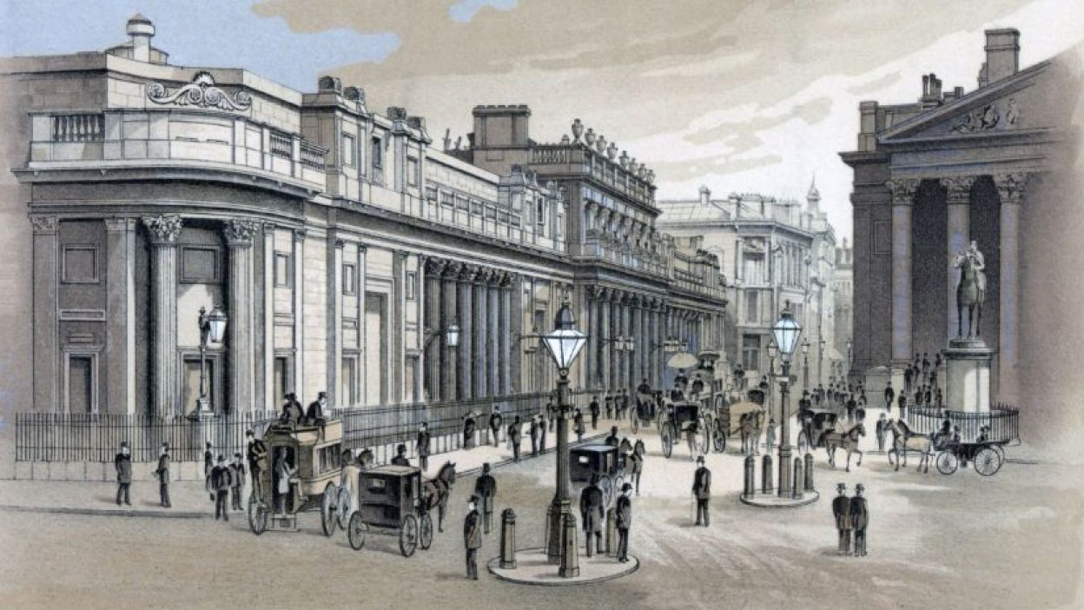
London Stock Exchange

Slide 36
Act 8
Last act ending with:
H.A.: (pensive, but then delighted when he reminisced of Hastings' shares) I'll settle my accounts in full this afternoon. It so happens that my real fortune is tied up in mining ... gold mining. Well, good morning, gentlemen. You're a fascinating species. Sometime you must take a good look at yourselves (hurry out the doorway, arrogant) ... under a microscope.

Slide 38
Act 9
NB: 沿用这个背景没啥问题; 另外, 结尾曲确实比较难选, 可以就用这首 (调音调的不错), 或者参考一下 ChatGPT:
"Time" by Hans Zimmer: This instrumental piece is emotional and uplifting, and could serve as a powerful accompaniment to the story's final moments.
"The Long and Winding Road" by The Beatles: This classic song has a reflective, melancholy tone that could complement the bittersweet ending of the story.
"Lux Aeterna" by Clint Mansell: This instrumental piece is hauntingly beautiful and could serve as a fitting accompaniment to the film's themes of wealth, power, and morality.
"The Winner Takes It All" by ABBA: This song's lyrics about the bittersweet nature of success and achievement could resonate with the film's themes and the story's conclusion.
“Everybody‘s Free (To Wear Sunscreen)” by Baz Luhrmann: This spoken-word song offers inspiring advice on how to live a fulfilling life and could serve as a positive and uplifting conclusion to the story. (此三首貌似不大适合)
Last act ending with:
N.: Remember our Portia? Well, as soon as the million pound note was found, the shares price of Good Hope mines peaked again, and Portia's aunt was quite content to receive the five thousand pounds that Henry has promised her. Busy counting money and boasting about her blueprint for the money, Portia's aunt definitely Portia to continue her relationship with Henry. But Portia never cared about those filthy bits of paper - she just badly wanted to see Henry.
(P.L. was escorted into the hall)
P.L. Henry! Oh, Henry.
(Without further words, the two hugged and kissed)

Slide 39
两个老头密谋打赌的场景 找不到合适的☹

Slide 40
弃用 已隐藏

